Slide 1


Slide 2

FTP CONNECTION

Slide 3
Outlines
Introduction
Abstract
Github-commits
flow chart
Work progress
Methodology
implementation

Slide 4
Introduction
File Transfer Protocol (FTP) is a communications protocol used to send files from computer to computer, with one of them acting as the server, providing the two have an Internet connection.
A networking protocol between client and server, FTP allows users to download web pages, files, and programs that are available on other services.
An FTP server is a computer program that is built to handle data transfer between computers. The server waits for clients to connect to it and issue commands that tell the server to upload, download, or list directories. The FTP protocol is the commands the FTP server uses to accomplish this.

Slide 5
Abstract
File Transfer Protocol is used for transferring files to clients over networks using client-server architecture.
FTP provides two mechanisms for file transfer; one is anonymous method and another one is password authentication mechanism.
We are using kali Linux in windows to make a FTP connection.

Slide 6
GITHUB COMMITS :

Slide 7
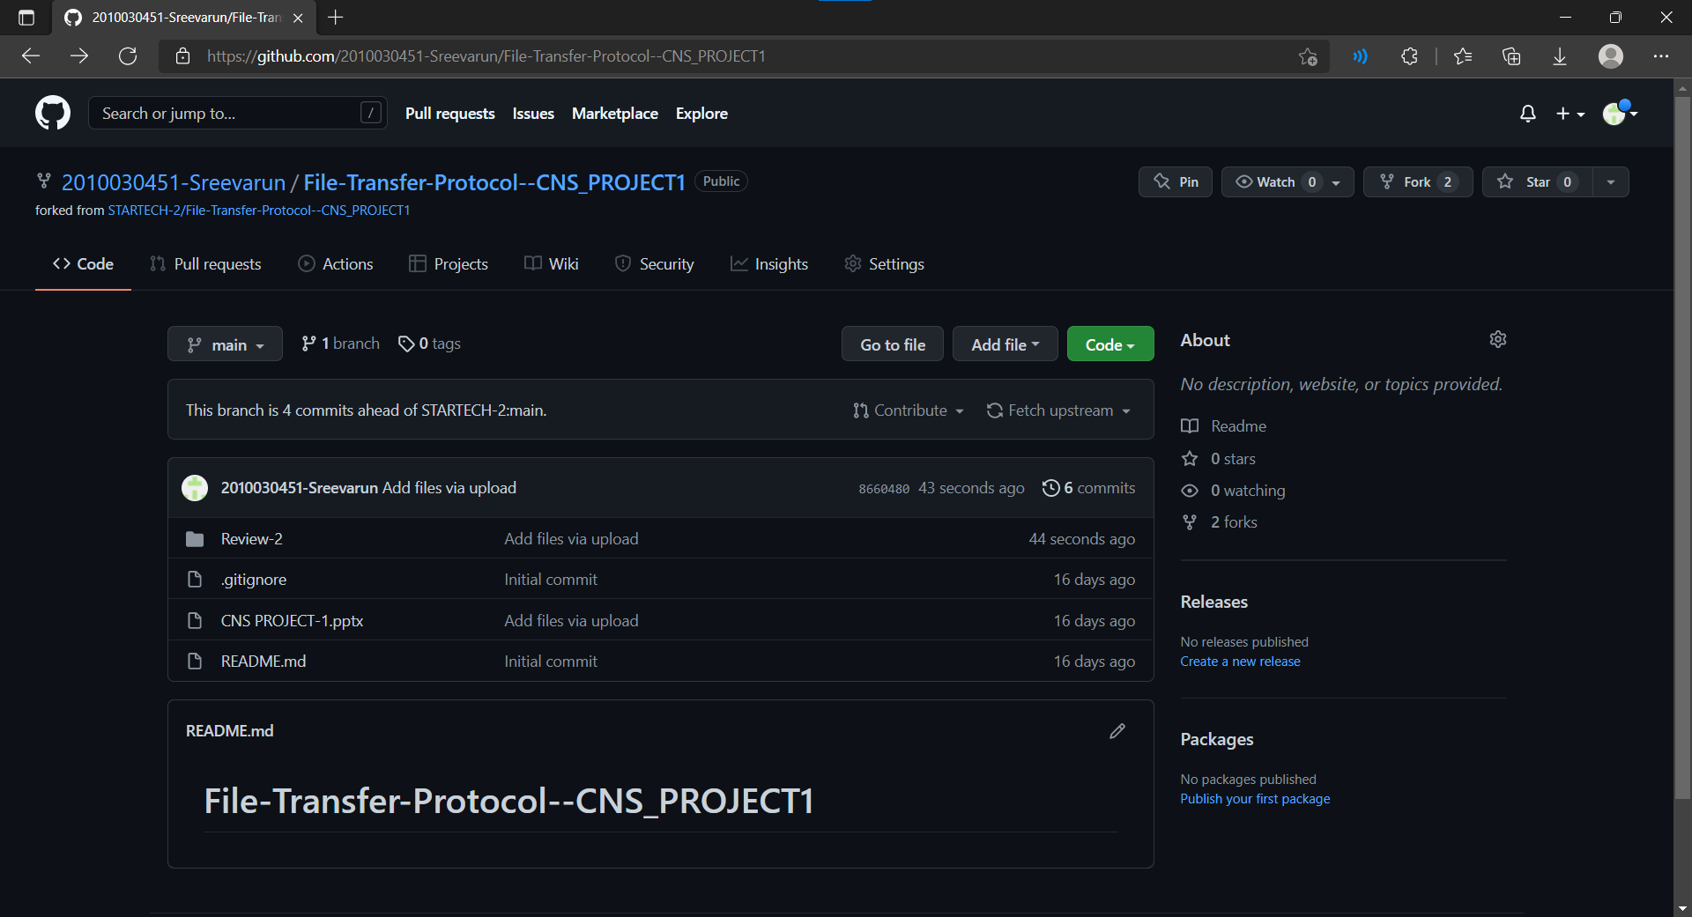

Slide 8
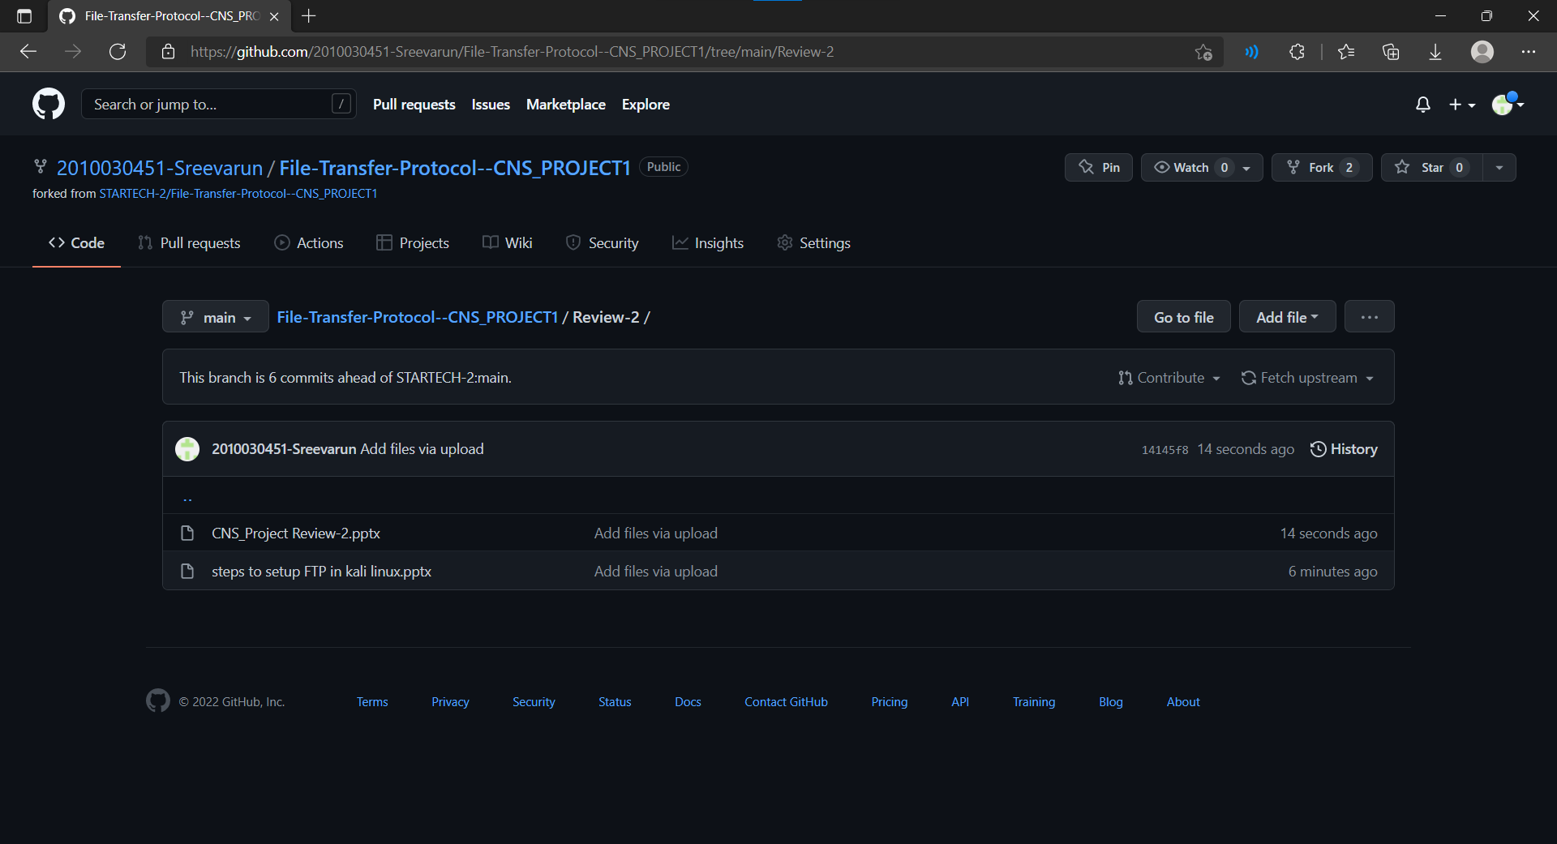

Slide 9
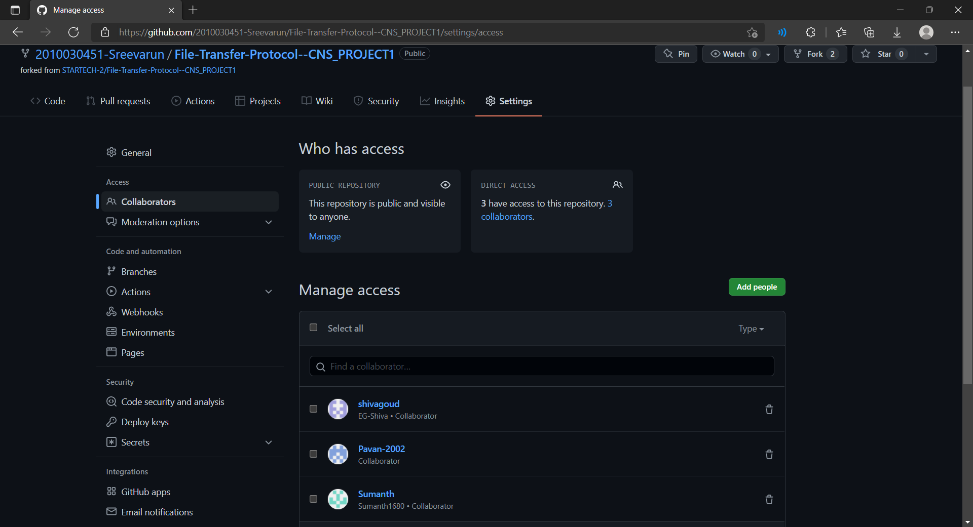

Slide 10

Flow chart

Slide 11
start
command
apt-get Install vsftpd
Make changes to the vsftpd.conf
command
apt-get Install ssh
Enter command
Sudo su
Open terminal in Kali linux
Add port forwarding for SSH
And FTP protocol
Open command prompt in windows
active
service ssh status
service vsftpd status
ssh username@127.0.0.1
Reboot kali linux
service ssh start
Service vsftpd start
ftp 127.0.0.1
Stop

Slide 12
WORK PROGRESS
Started working on kali linux and windows.
Got more idea about working methods.
Completed github commits of project
Working on linux environment.
Starting the implementing process

Slide 13
Methodology
Install vsftpd package and make the changes to the configuration
Start the vsftp service
Use command prompt to connect to kali Linux ftp server

Slide 14
IMPLEMENTATION

Slide 15
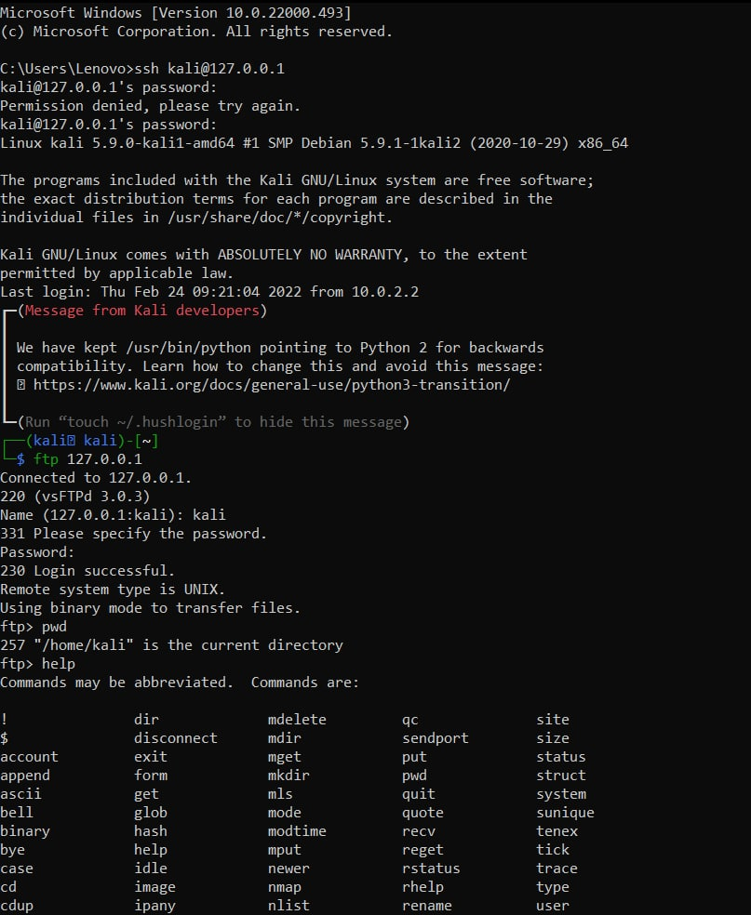
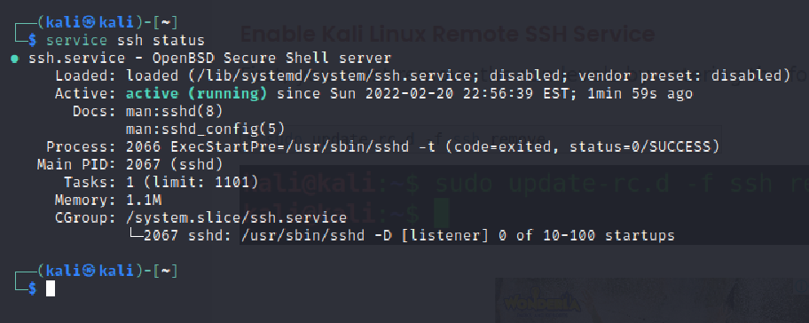
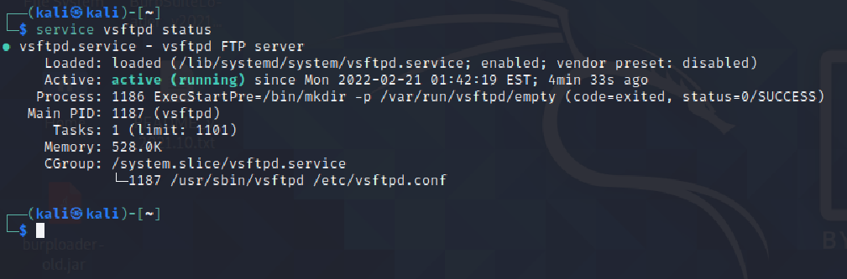

Slide 16


